Slide 1
General Companion Animal Knowledge
Diets for Dogs
Exercise for Dogs
Grooming
Famous Cartoon Dogs
10
10
10
10
10
20
20
20
20
20
30
30
30
30
30
40
40
40
40
40
50
50
50
50
50

Slide 2
General Companion Animal Knowledge

Slide 3
Category 1
This is another name for companion animal.
10

Slide 4
Category 1
What is pet.
10

Slide 5
Category 1
This companion animal has a wet nose.
20

Slide 6
Category 1
What is a dog.
20

Slide 7
Category 1
This is who companion animals depend on for their care.
30

Slide 8
Category 1
Who is humans.
30

Slide 9
Category 1
These are the three basic needs of companion animals.
40

Slide 10
Category 1
What are water, food, and shelter.
40

Slide 11
Category 1
Dogs often like to do this in the dirt or sand.
50

Slide 12
Category 1
What is dig.
50

Slide 13
Diets for Dogs

Slide 14
Category 2
Puppies get this from their moms.
10

Slide 15
Category 2
What is milk.
10

Slide 16
A bowl of this should be changed at least once a day.
20

Slide 17
Category 2
What is water.
20

Slide 18
Category 2
Name one thing that impacts the amount of food you give your dog.
30

Slide 19
Category 2
What is age, size, or activity level.
30

Slide 20
Category 2
This dark sweet treat should never be given to dogs.
40

Slide 21
Category 2
What is chocolate.
40

Slide 22
Category 2
Obesity is caused by doing this.
50

Slide 23
Category 2
What is overeating.
50

Slide 24
Exercise for Dogs

Slide 25
Category 3
This is the minimum amount of time a dog should exercise.
10

Slide 26
Category 3
What is 30 minutes.
10

Slide 27
Category 3
This is where you throw a ball and your dog brings it back to throw again.
20

Slide 28
Category 3
What is fetch.
20

Slide 29
Category 3
This type of exercise is in the water.
30

Slide 30
Category 3
What is swimming.
30

Slide 31
Category 3
What are two items your dog should be wearing before going on a walk?
40

Slide 32
Category 3
What is a collar and leash.
40

Slide 33
Category 3
Exercise will help prevent your dog from becoming this.
50

Slide 34
Category 3
What is obese.
50

Slide 35
Grooming

Slide 36
Category 4
Doing this will keep your dogs coat healthy.
10

Slide 37
Category 4
What is brushing.
10

Slide 38
Category 4
You should do this once a month to your dog.
20

Slide 39
Category 4
What is give a bath.
20

Slide 40
Category 4
Brushing your cat will decrease these from getting stuck in your cats throat.
30

Slide 41
Category 4
What is a hairball.
30

Slide 42
Category 4
You do this every day and pets need it done to their mouths too.
40

Slide 43
Category 4
What is brushing teeth.
40

Slide 44
Category 4
This is what the temperature should be for your dogs bath.
50

Slide 45
Category 4
What is warm. (Or- What is the same temperature as my bath.)
50

Slide 46
Famous Cartoon Dogs

Slide 47
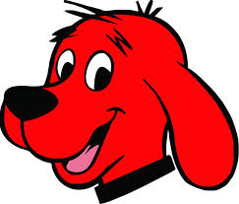
Category 5
10

Slide 48
Category 5
Who is Clifford.
10

Slide 49
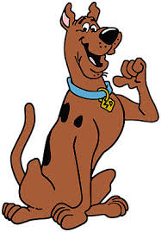
Category 5
20

Slide 50
Category 5
Who is Scooby Doo.
20

Slide 51
Category 5
30

Slide 52
Category 5
Who is Snoopy.
30

Slide 53
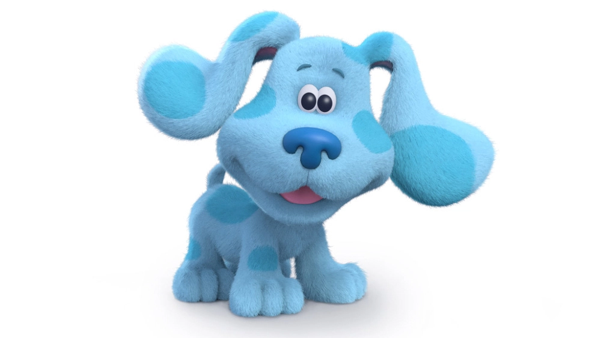
Category 5
40

Slide 54
Category 5
Who is Blue.
40

Slide 55
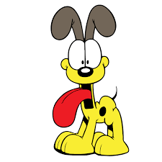
Category 5
50

Slide 56
Category 5
Who is Odie.
50

